Slide 1
COLD WAR RECAP
Cold War (1945-1991)
US vs. Soviet Union
Capitalism vs. Communism
War of Ideas

Slide 2
COLD WAR RECAP
Containment Policy:
Trying to stop the spread of communism
Key Events:
Berlin Airlift
Cuban Missile Crisis
Korean War
Vietnam War
Who wins? The Free World (USA)

Slide 3
MODERN GLOBAL CONFLICTS
Goals of US Foreign Policy:
Maintaining national security
Supporting democracy
Promoting world peace
Providing aid to people in need
Open trade
New goal added after 2001:
Fight against terrorism at home and abroad

Slide 4
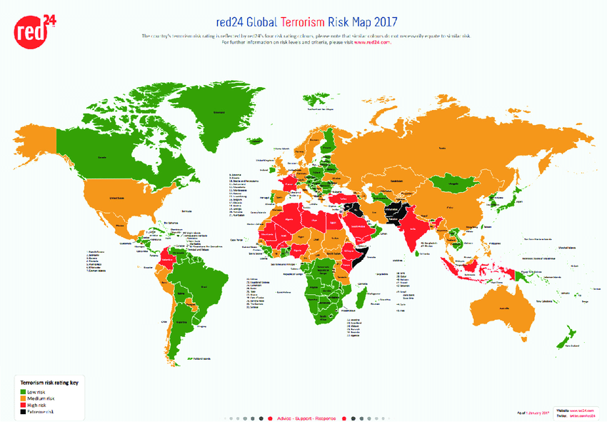
MODERN GLOBAL CONFLICTS

Slide 5
MODERN GLOBAL CONFLICTS
Terrorism:
Using violence against civilians to achieve political goals
Terrorists:
Individuals or groups who use violence against civilians to achieve political goals

Slide 6
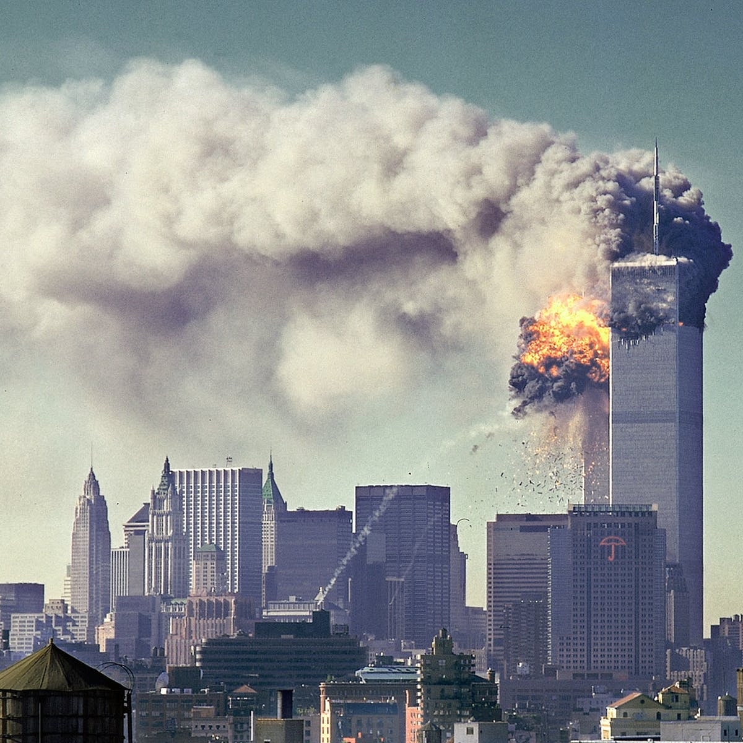
MODERN GLOBAL CONFLICTS
Why use terrorism?
Terrorists try to change people’s minds and actions through fear
Terrorists attack civilians
to get attention for their
cause or ideals
Terrorists try to send a
message to governments
or citizens

Slide 7
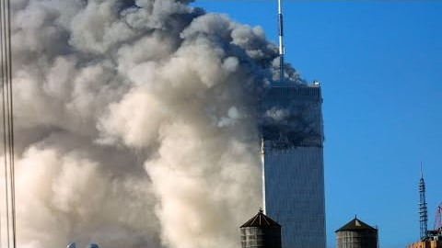
SEPTEMBER 11, 2001

Slide 8
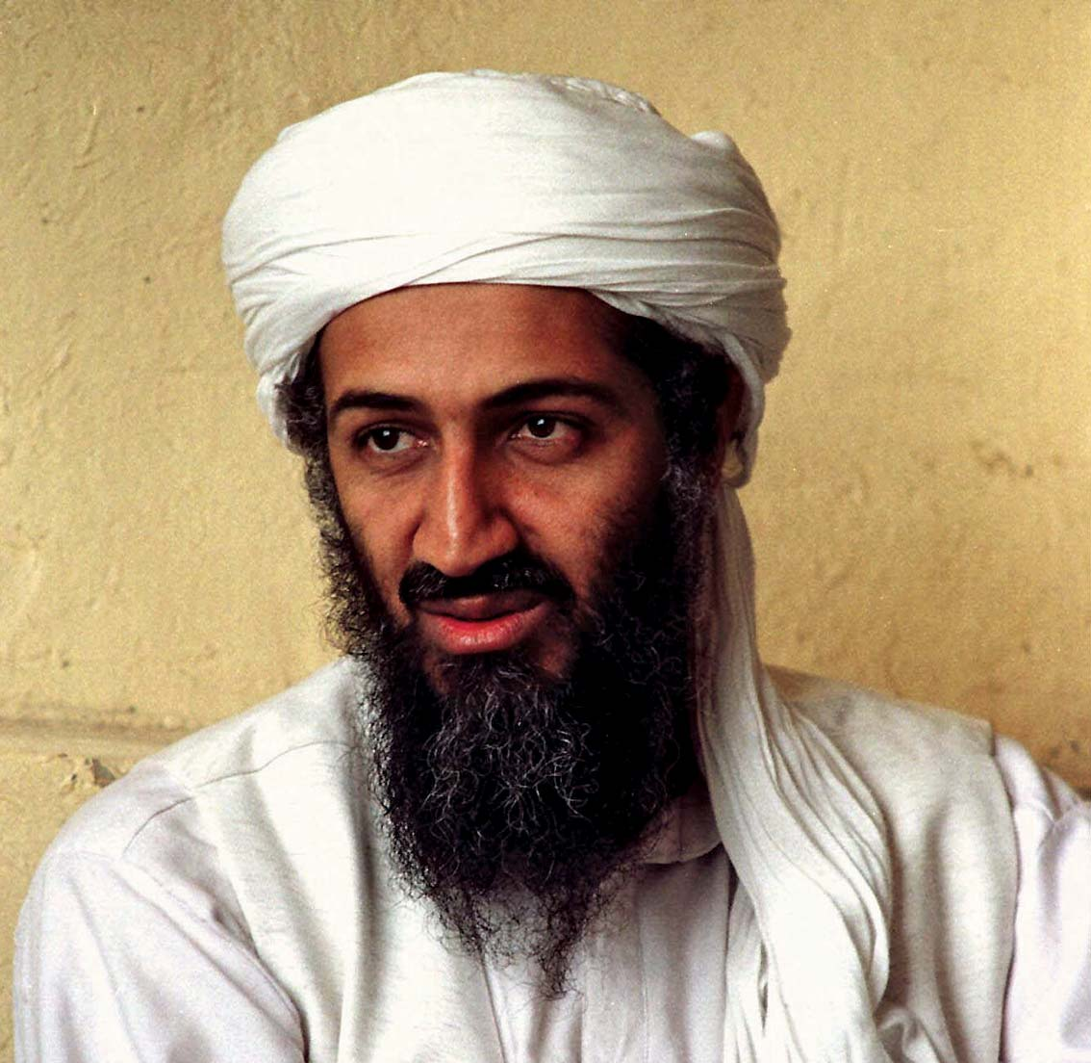
MODERN GLOBAL CONFLICTS
September 11, 2001
Al-Qaeda coordinates attacks that kill 2,977 Americans on the morning of 9/11/01 by hijacking planes and flying them into the World Trade Center and Pentagon.
Leader of Al-Qaeda:
Osama Bin Laden

Slide 9
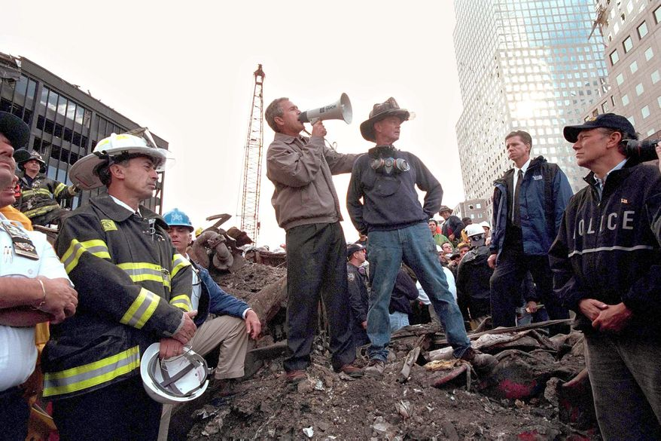
US RESPONSE TO 9/11 & TERRORISM

Slide 10
MODERN GLOBAL CONFLICTS
US Response:
2001: Invasion of Afghanistan, who was sheltering and giving help to Bin Laden & Al-Qaeda
2003: Invasion of Iraq, who was led by a dictator who threatened world peace: Saddam Hussein
Creation of Department of Homeland Security

Slide 11
ASSIGNMENT
Read p. 619-624.
As you read, answer the questions on the Word doc that go with the reading.

